Slide 1


OpenChain-开源软件供应链管理和
安全保障认证实践
OpenEuler’s Conformance TO
ISO/IEC 18974
Certification Proposal
裘键 – 网络安全与合作伙伴业务经理
2024

Slide 2
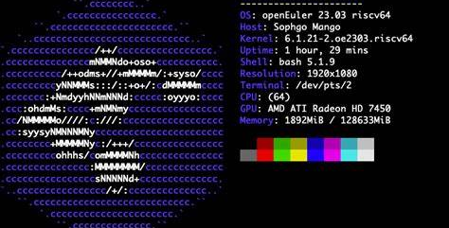
CRA Guidance
01.
00.
Adoption by openEuler

Slide 3
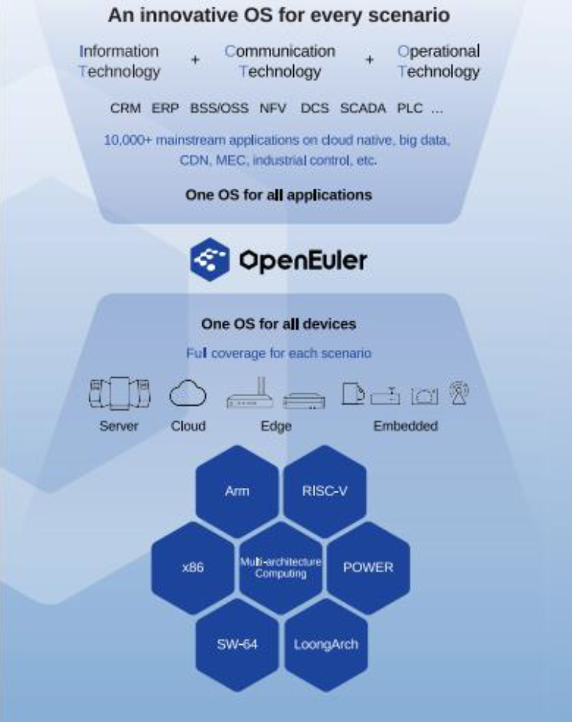
Overview
00/Adoption by openEuler
ISO/IEC 18974:2023 is an international standard maintained by the OpenChain Project, which defines the key requirements of establishing and managing a quality open-source security assurance program.
This study analyzes the rationale behind openEuler'sadoption of ISO/IEC 18974:2023 and shares best practices derived from this process.These practices have empowered the openEuler community to optimize processes, cultivate talent, construct community rules, and enhance the security of open-source software releases.

Slide 4



Understanding ISO/IEC 18974:2023
00/Adoption by openEuler
The ISO/IEC 18974:2023 is the standard maintained by the OpenChainProject, which defines the key requirements of a quality open-source security assurance program.
ISO/IEC 18974 helps organizations check open source for known security vulnerability issues like CVEs, GitHub dependency alerts or package manager alerts. It is lightweight, easy to read and is supported by our global community with free reference material and conformance resources.
It identifies
The key places to have security processes
How to assign roles and responsibilities
How to ensure sustainability of the processes

Slide 5
CRA Guidance
01.
01.
openEuler enhanced security study

Slide 6
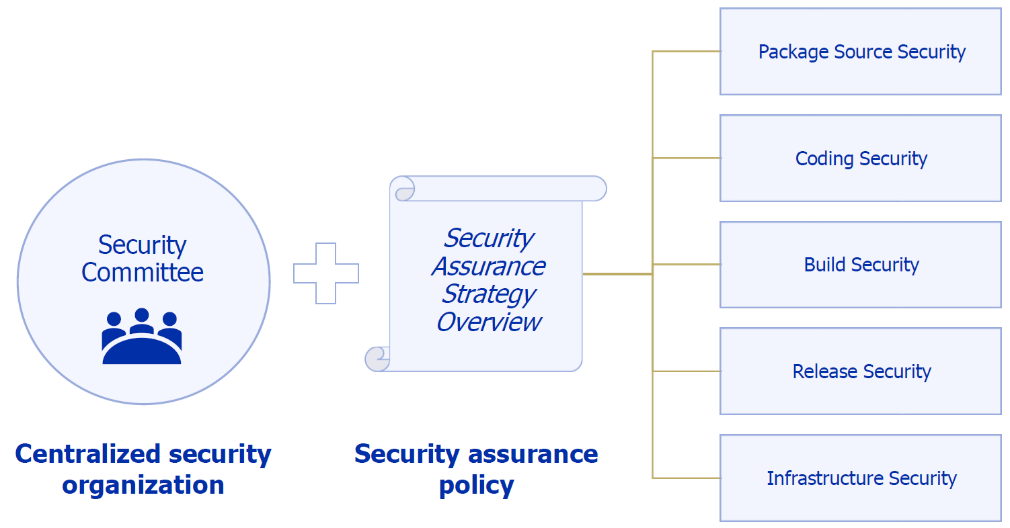
Centralized Security governance
01/openEuler enhanced security study

Slide 7
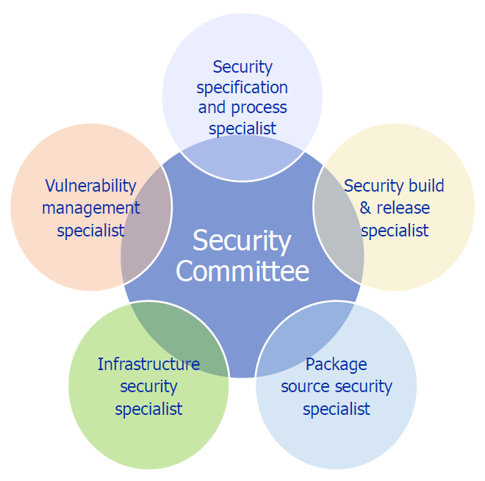
Security organization structure
01/openEuler enhanced security study
openEuler has established a Security Committee and defined security roles to assign internal responsibilities.
These members collaborate with, supervise, and guide maintainers from other SIGs to ensure policy implementation.

Slide 8
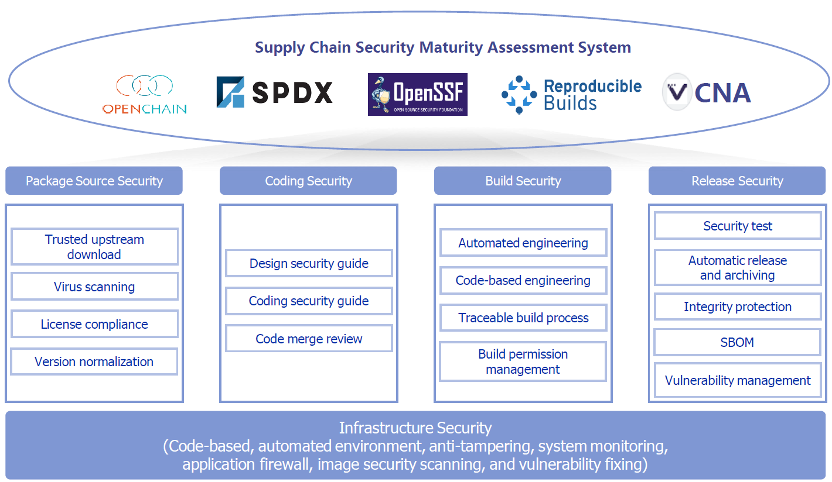
Security ASSURANCE POLICY
01/openEuler enhanced security study
Referencing the industry's open source software supply chain security maturity assessment system, openEuler has developed community security policies across the entire software development lifecycle (SDLC).

Slide 9
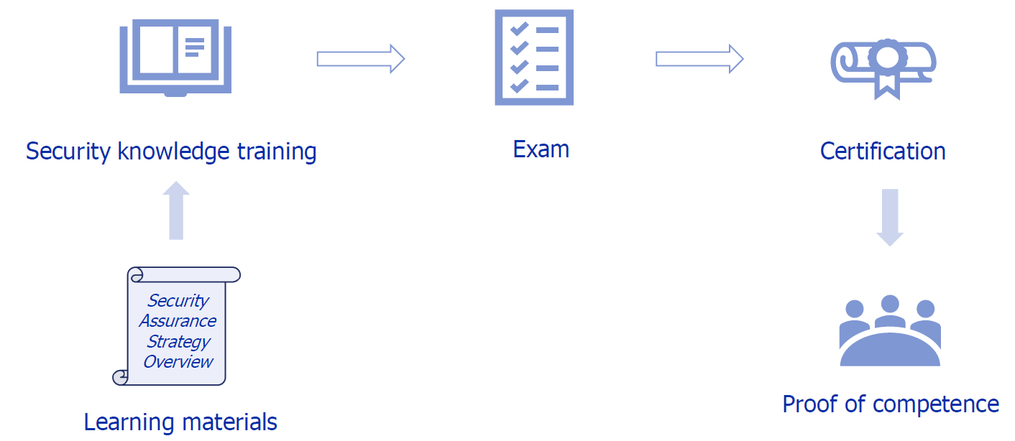
Competence & awareness
01/openEuler enhanced security study

Slide 10
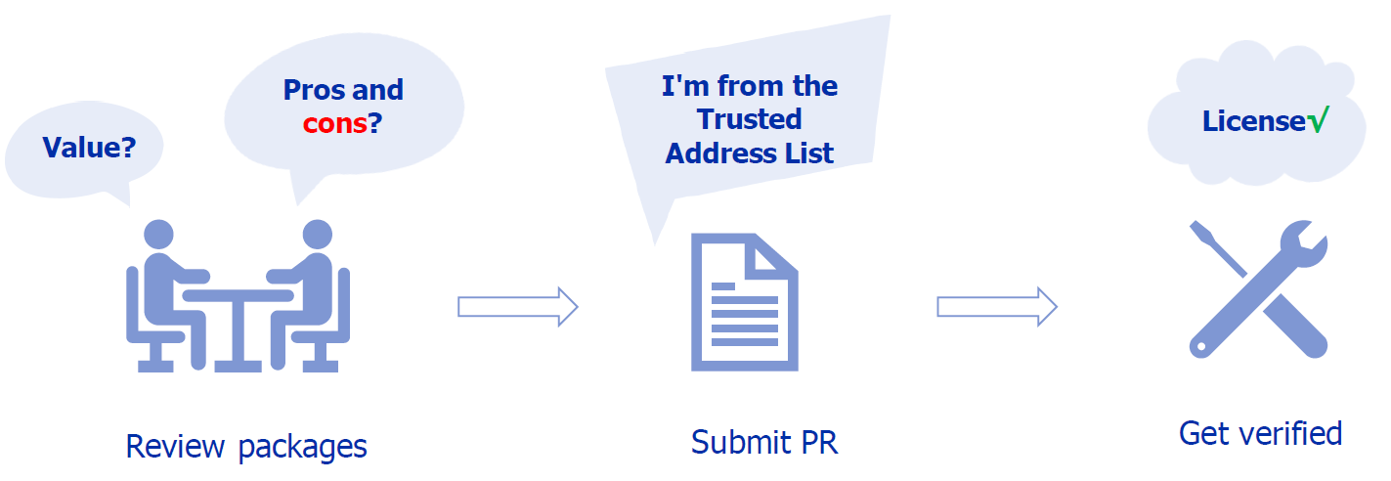
Package source review
01/openEuler enhanced security study
To build the provenance trust in the supply chain, every package source is thoroughly reviewed before being deployed in our releases.

Slide 11
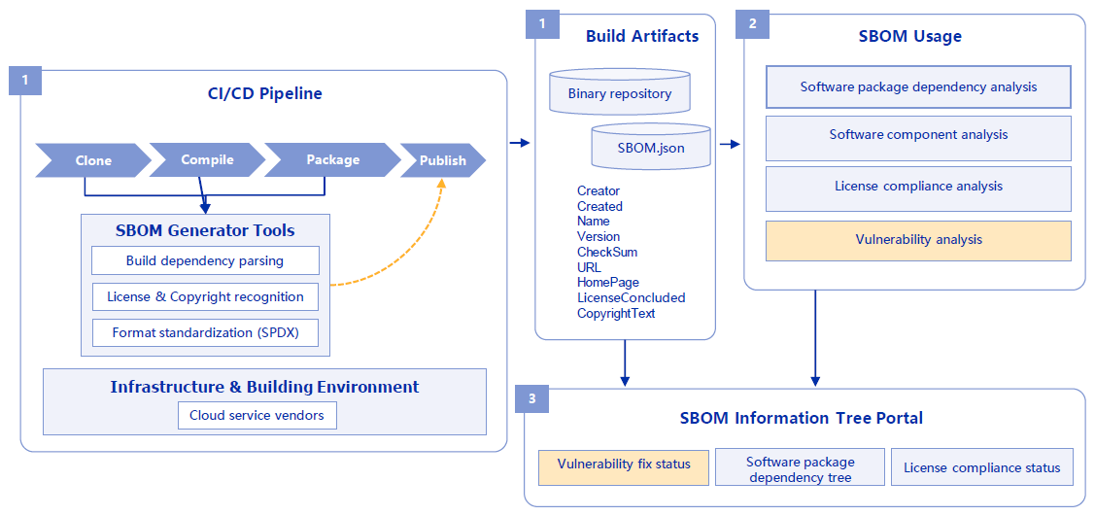
SBOM-based vulnerability management
01/openEuler enhanced security study
Data generation & storage:
SBOM is automatically generated based on CI/CD pipeline and stored with the products.
Data consumption:
Integrity verification, license compliance, and vulnerability awareness based on SBOM.
Online service:
SBOM online portal, displaying package dependencies and the status of vulnerability fixes and license compliance.

Slide 12
CRA Guidance
01.
02.
Our Proposal

Slide 13
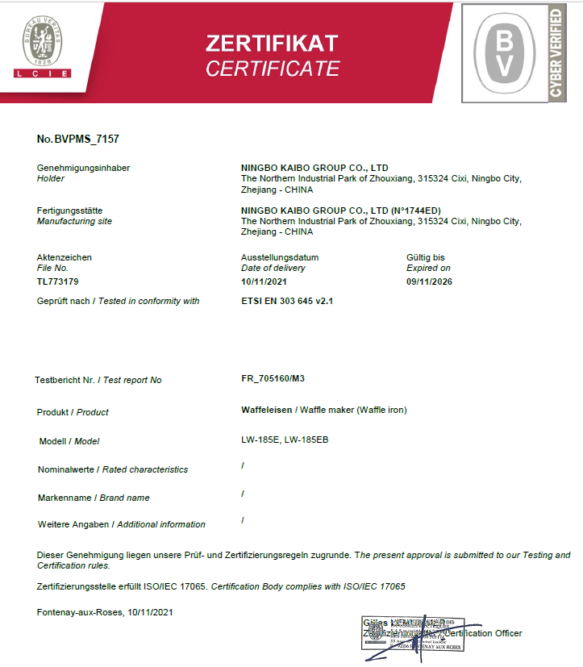
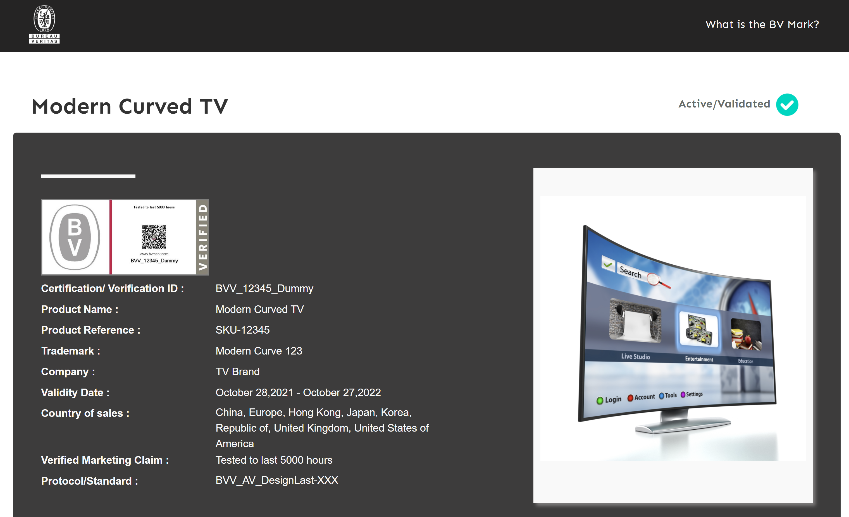

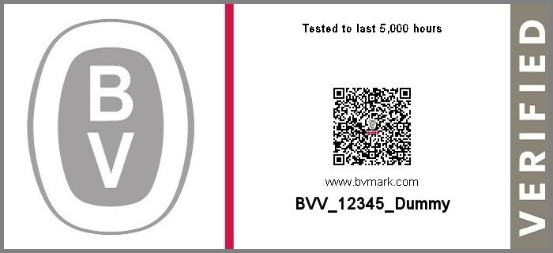
Certification Proposal 1
BV Cyber Mark
ISO 18974 Certification
Kick off
Gap Analyze
Assessment Evaluation
Certification

Slide 14

WWW.BUREAUVERITAS.COM

Slide 15
CRA Guidance
01.
03.
Inspection technique point

Slide 16
POLICY
02/OUR PROPOSAL
A written policy shall be created that governs open source software security assurance of supplied software. The policy shall be internally communicated. The policy and its method of communication shall have a review process to ensure they are current and relevant.
Verification material(s):
4.1.1.1: A documented open source software security assurance policy;
4.1.1.2: A documented procedure to make program participants aware of the security assurance policy.

Slide 17
Competence
The organization shall:
Identify the roles and responsibilities that impact the performance and effectiveness of the program;
Determine the necessary competence of program participants fulfilling each role;
Ensure that program participants have appropriate education, training, and/or experience;
Where applicable, ensure program participants take actions to acquire the necessary competence;
Retain appropriate documented information as evidence of competence as well as who is currently a participant in the program.
Verification material(s):
4.1.2.1: A documented list of roles with corresponding responsibilities for the different program participants;
4.1.2.2: A document that identifies the competencies for each role;
4.1.2.3: List of participants and their roles;
4.1.2.4: Documented evidence of assessed competence for each program participant;
4.1.2.5: Documented evidence of periodic reviews and changes made to the process;
4.1.2.6: Documented verification that these processes are current with company internal best practices and who is assigned to accomplish them.

Slide 18
AWARENESS
The organization shall ensure that the program participants are aware of:
The open source software security assurance policy;
Relevant program objectives;
Their contribution to the effectiveness of the program;
The implications of not following the program’s requirements.
Verification material(s):
4.1.3.1: Documented evidence of assessed awareness for the program participants - which should include the program’s objectives, one’s contribution within the program, and implications of program non-conformance.

Slide 19
Program scope
A program should have defined guiding principles and scope that match the risk management policy of the entire organization. It should be clear whether the program applies to a product line, a department, or the entire organization. It should also be understood that this scope may change over time and metrics may be used to assess its ongoing effectiveness.
Verification material(s):
4.1.4.1: A written statement that clearly defines the scope and limits of the program;
4.1.4.2: A set of metrics the program shall achieve to improve;
4.1.4.3: Documented evidence from each review, update, or audit to demonstrate continuous improvement.

Slide 20
Standard practice implementation
The program shall demonstrate sound and robust handling procedures of known vulnerabilities and secure software development by defining and implementing following procedures:
Method to identify structural and technical threats to the supplied software;
Method for detecting existence of known vulnerabilities in supplied software;
Method for following up on identified known vulnerabilities;
Method to communicate identified known vulnerabilities to customer base when warranted;
Method for analyzing supplied software for newly published known vulnerabilities post release of the supplied software;
Method for continuous and repeated security testing to be applied for all supplied software before release;
Method to verify that identified risks will have been addressed before release of supplied software;
Method to export information about identified risks to third parties as appropriate.
Verification material(s):
4.1.5.1: A documented procedure exists for each of the methods identified above..

Slide 21
Access
The program shall maintain a process to effectively respond to external known vulnerability inquiries. To accomplish this, it shall publicly identify a means for third parties to inquire about how a known vulnerability impacts a software offering.
Method to identify structural and technical threats to the supplied software;
Method for detecting existence of known vulnerabilities in supplied software;
Method for following up on identified known vulnerabilities;
Method to communicate identified known vulnerabilities to customer base when warranted;
Method for analyzing supplied software for newly published known vulnerabilities post release of the supplied software;
Method for continuous and repeated security testing to be applied for all supplied software before release;
Method to verify that identified risks will have been addressed before release of supplied software;
Method to export information about identified risks to third parties as appropriate.
Verification material(s):
4.2.1.1: Publicly visible method to allow third parties to make known vulnerability or newly discovered vulnerability enquires (e.g., via an email address or web portal that is monitored by program participants);
4.2.1.2: An internal documented procedure for responding to third party known vulnerability or newly discovered vulnerability inquiries.

Slide 22
Effectively resourced
Ensure the following tasks relevant to the program are identified and resourced to meet the process requirements of this document:
Assign accountable personnel to ensure the successful execution of program tasks;
Program tasks are sufficiently resourced;
Sufficient time to perform the tasks have been allocated;
Adequate funding has been allocated;
A process exists for reviewing and updating the policy and supporting tasks;
Technical expertise pertaining to known vulnerabilities is accessible to those who may need such guidance.
Verification material(s):
4.2.2.1: Document with name of persons, group or function in program role(s) identified;
4.2.2.2: The identified program roles have been properly staffed and adequate funding provided;
4.2.2.3: Identification of expertise available to address identified known vulnerabilities;
4.2.2.4: A documented procedure that assigns internal responsibilities for security assurance.

Slide 23
Software bill of materials
A process shall exist for creating and maintaining a bill of materials that includes each open source software component from which the supplied software is comprised.
Verification material(s):
4.3.1.1: A documented procedure ensuring all open source software used in the supplied software is continuously recorded across the lifecycle of the supplied software. This includes an archive of all open source software used in the supplied software;
4.3.1.2: open source software component records for the supplied software that demonstrates the documented procedure was properly followed.

Slide 24
Security assurance
A process shall exist to ensure each open source software component to be included in the software bill of materials for the supplied software will have some security assurance activities applied.
Apply method for detecting existence of known vulnerabilities;
For each identified known vulnerability assign a risk/impact score;
For each detection and assigned score determine and document necessary remediation or mitigation steps suitable for the use-case of the software
Obtain Customer Agreement that the proposed resolution is acceptable if necessary; at or above a previously determined level (i.e., all severity scores above 4.5 …);
— Depending on the risk/impact score take the appropriate action (e.g., contact customers if necessary, upgrade software component, no further action, …);
— If a newly discovered vulnerability is present in previously distributed supplied software, depending on the risk/impact score take the appropriate action (e.g., contact customers if warranted);
— An ability to monitor supplied software after its release to market and to respond to known vulnerability or newly discovered vulnerability disclosures.
Verification material(s):
4.3.2.1: A documented procedure for handling detection and resolution of known vulnerabilities for the open source software components of the supplied software;
4.3.2.2: For each open source software component a record is maintained of the identified known vulnerabilities and action(s) taken (including even if no action was required).

Slide 25
Completeness
For a program to conform with this specification, the organization shall affirm that the program satisfies the requirements presented in this document.
Verification material(s):
4.4.1.1: Documented evidence affirming the program specified in 4.1.4 satisfies all the requirements of this document.

Slide 26
Duration
A program that is OpenChain conformant with this version of the specification shall last 18 months from the date conformance validation was obtained. The conformance validation registration procedure can be found on the OpenChain project's website.
Verification material(s):
— 4.4.2.1: A document affirming the program meets all the requirements of this specification, within the past 18 months of obtaining conformance validation.

